Slide 1
African literary arts – part 2
Proverbs into symbols
Fiction writing in Nigeria:
The novel as case study

Slide 2
African literary arts – part 2
Visual Symbols and communication
Novels
Poems / Volumes of poetry
Prose (Non-fiction)
Short stories
Plays (drama)
Symbolic traditions
Written traditions

Slide 3
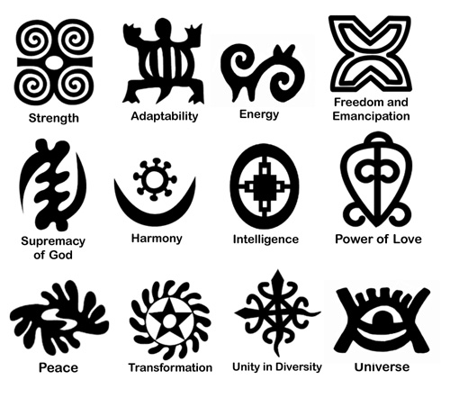
Proverbs Represented by visual symbols
Adinkra patterns
Common symbols
Patterns in cloth & objects.
Akan symbols stamped on fabric or carved in wood.
multilayered metaphors that represent proverbs, maxims and parables, record historical events, express universal values, and concepts uniquely related to how people should treat one another.
Notes:
www.ishangi.org/ adinkra_workshop
Adinkra cloths made from yellow or white cotton fabrics are worn for happy occasions, such as weddings, naming ceremonies or rites of passage, whereas dark colors are traditionally used for funerals. Adinkra means “goodbye” and is a non-verbal communication of farewell to the deceased and condolence to the grieving family.
Adinkra symbol designs are cut out of gourds, and then thin wood sticks, bound with twine, are attached to the gourd pieces to make handles

Slide 4
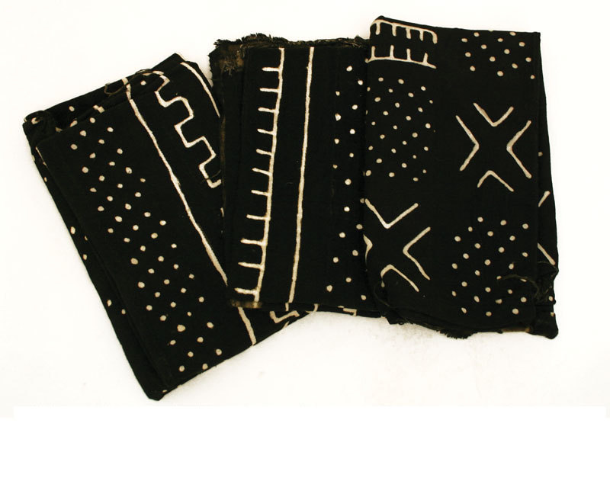
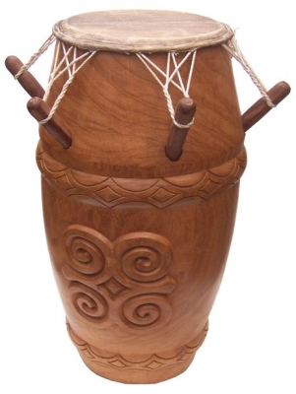
the "art of silent oratory."
Proverbs & symbolized meanings on cloth and through carvings
Ghanain drum - Kpanlogo
Notes:
www.etsy.com/listing/ 91907126/black-and-white...
http://www.wwdrums.com/images/products/preview/kpl_nat.jpg

Slide 5
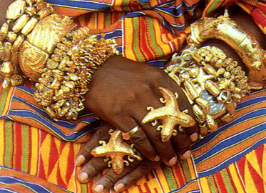
Symbolic communication
Rings on this Akan chief…
encode the folklore of Siamese twin crocodiles that are joined in the stomach.
This symbol depicts the Akan political belief of democracy
Democracy and oneness irrespective of ethnic and cultural differences.
Notes:
Democracy and oneness irrespective of cultural differences.
Funtumfunafu denkyemfunafu, won afuru bom, nso woredidi a na woreko.
“They share one stomach and yet they fight for getting food.”
http://www.stlawu.edu/gallery/education/f/09textiles/adinkra_symbols.pdf

Slide 6
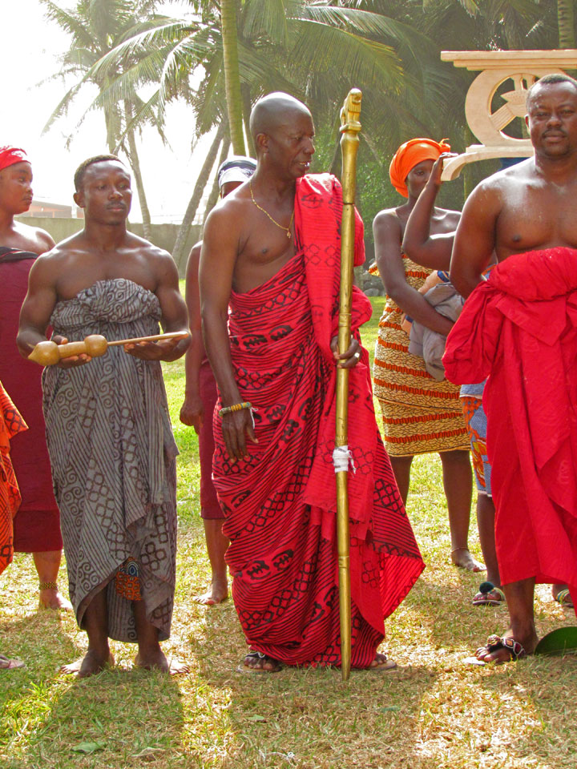
Proverbs Represented by symbolism
Staffs and the Objects associated with leadership
Example:
Ghanain Spokesmen and their staffs use a combination of symbolic communication and orature: more literal visual image representing proverbs

Slide 7
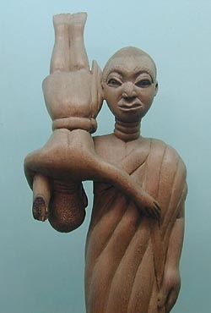
Ghana: Akan royal oratory
Spokesmen carry these ornate staffs
heads of the staff are carved to represent a proverb, such as
‘If you try to jump over the shoulder of your elder, you will get caught up in his armpit!’ This advises people not to get too uppity and rebellious against their elders.
Notes:
http://www.conradiator.com/essays/ghanamuseum.html

Slide 8
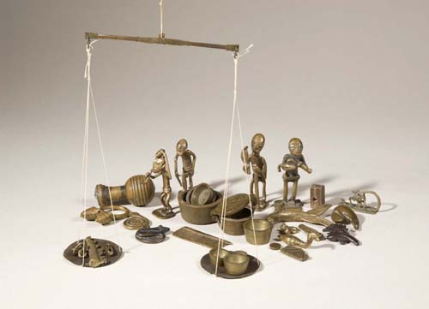
Gold weights - currency embodying popular sayings
Ghana: Akan gold weights
A way that Akan people encoded and transmitted their knowledge
Often dealing with issues…such as
Social and political inequality
Conflict resolution

Slide 9
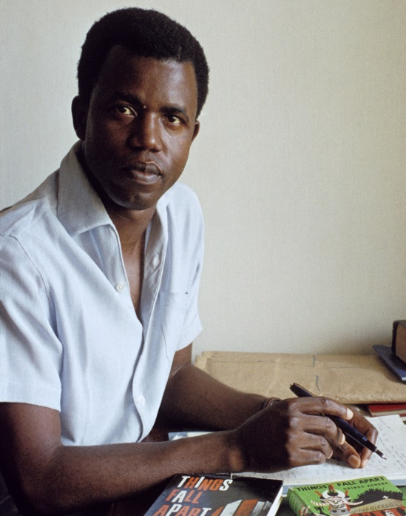
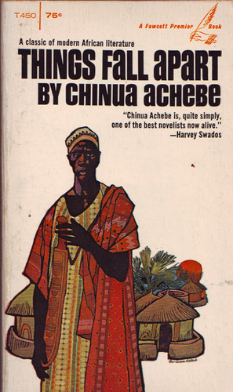
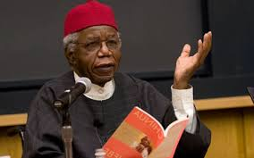
The Novel in Nigeria
By Chinua Achebe
Things Fall Apart (1958) retells the moment of colonialism, and the encounter between the Igbo people and the British, from the perspective of the African people and a traditional community.

Slide 10
Other works by Chinua Achebe
Arrow of God (1964)
later moment in colonial history
No Longer at Ease (1960), Man of the People (1966), and Anthills of the Savannah (1987)
Corruption and contradictions of post-independence era.

Slide 11
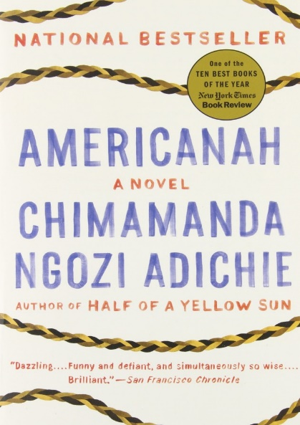
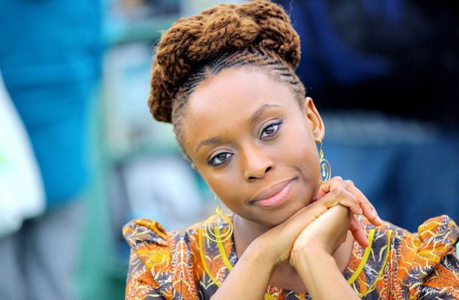
Nigerian author: fiction writer
Award winning African author Chimamanda Ngozi Adichie
In her book Americanah (2013) she mirrors some of the central issues of her own life; race, immigration and the power of hair.
See interview with Jon Snow
https://www.youtube.com/watch?v=-n8LtRi2i8c

Slide 12
Other works by
Chimamanda Ngozi Adichie
Purple Hibiscus (2003), which won the Commonwealth Writers’ Prize and the Hurston/Wright Legacy Award
Half of a Yellow Sun (2006), which won the Orange Prize and was a National Book Critics Circle Award Finalist and a New York Times Notable Book.
Author’s website: https://www.chimamanda.com/

Slide 13
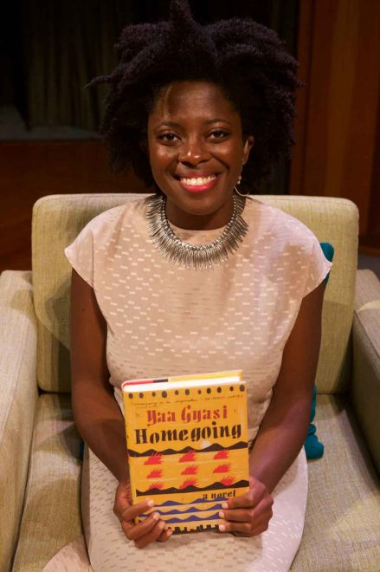
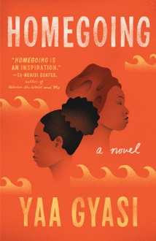
Ghanain American Author: Yaa Gyasi
Yaa Gyasi – Discusses Debut Novel Homegoing 3:02 mins.
Wallstreet Journal Published May 6 2016. Accessed 10 October 2018. https://www.youtube.com/watch?v=wheQsYCDezE

